Slide 1

PROJECT ON
"SCRAPING AND ANALYZING RESTAURANT TRENDS: AN EDA APPROACH USING EAZYDINER DATA"
By – Venkatesh V. Karnure.

Slide 2
ABOUT ME
Name - Venkatesh Vijay Karnure.
Education - B.Sc. Computer Science
Linkedin - https://www.linkedin.com/in/venkateshk2003
Github - https://github.com/Venkatesh9372

Slide 3
What Types Of Cuisines Are Most Offered In Different City?
Which Areas Have The Top-Rated Restaurants?
Which Restaurant Categories (E.G., Cafes, Fine Dining, Casual) Offer The Best Discounts Or Highest Ratings?
PROBLEM STATEMENT
The Objective Of This Project Is To Automate The Extraction Of Restaurant Data From Eazydiner Using Web Scraping Techniques And Transform It Into A Structured Dataset.
This Dataset Is Then Used To Perform Exploratory Data Analysis (EDA) On Key Features Such As Ratings, Cuisines, Locations, Discounts, And Pricing Across Multiple Major Indian Cities.
The Goal Is To Uncover Meaningful Patterns, Trends, And Insights That Can Inform Consumer Behavior, Regional Preferences, And Market Opportunities In The Urban Food Industry.
OBJECTIVE

Slide 4
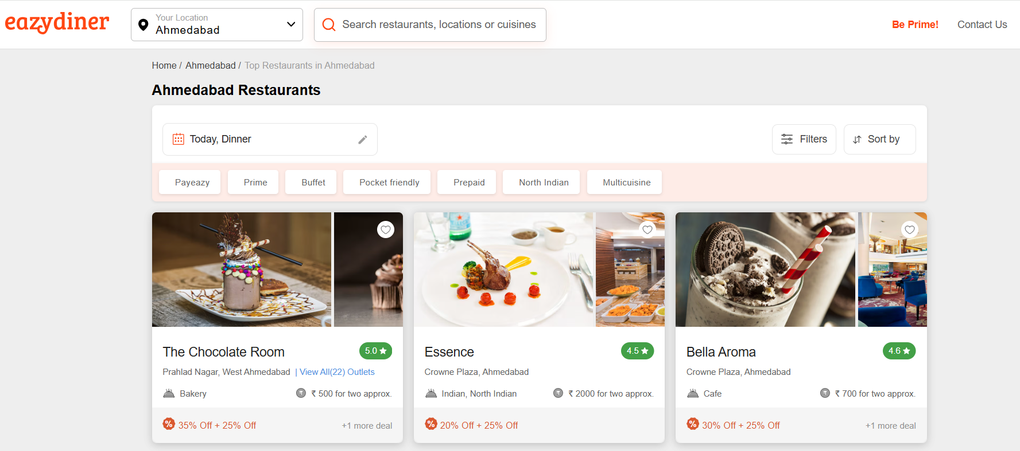
The website used for Web Scrapping and obtained the data from –
https://www.eazydiner.com/

Slide 5
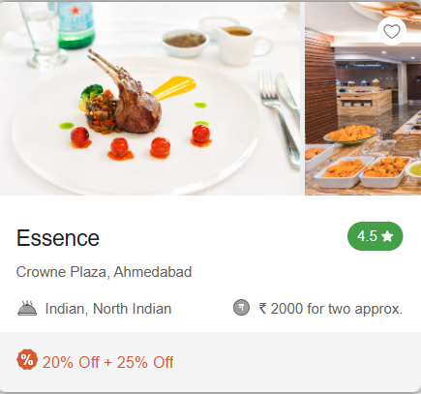
FEATURES EXTRACTED
Columns
Name Of The Restaurant
Rating
Cuisine Served
Location
Approximate Cost For 2
Discount

Slide 6
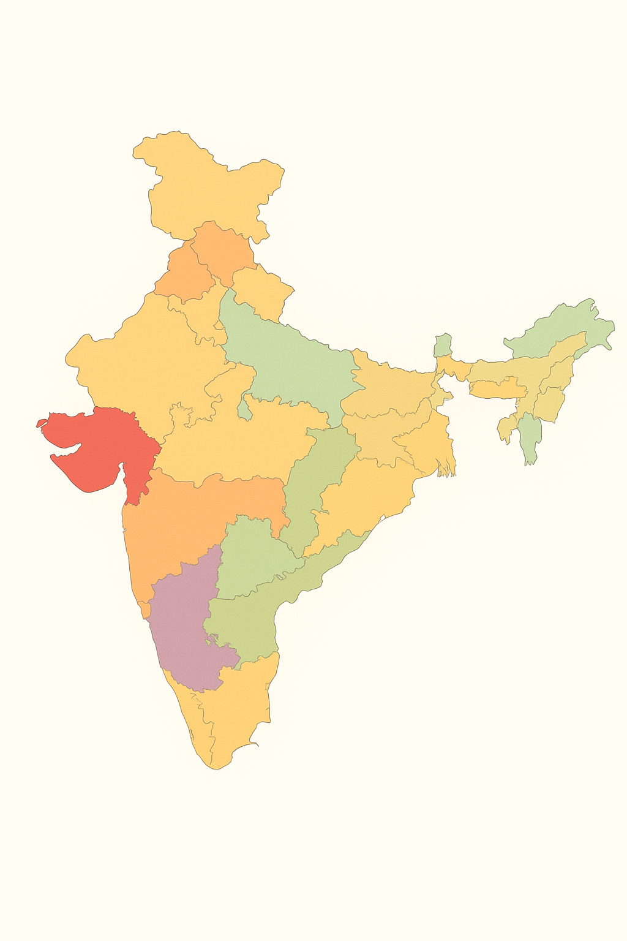





I Have Extracted Details Of Restaurants From 5 Major Cities In India – Ahmedabad, Mumbai, Pune, Bengaluru​, Hyderabad
Ahmedabad
Mumbai
Hyderabad
Pune
Bangalore

Slide 7
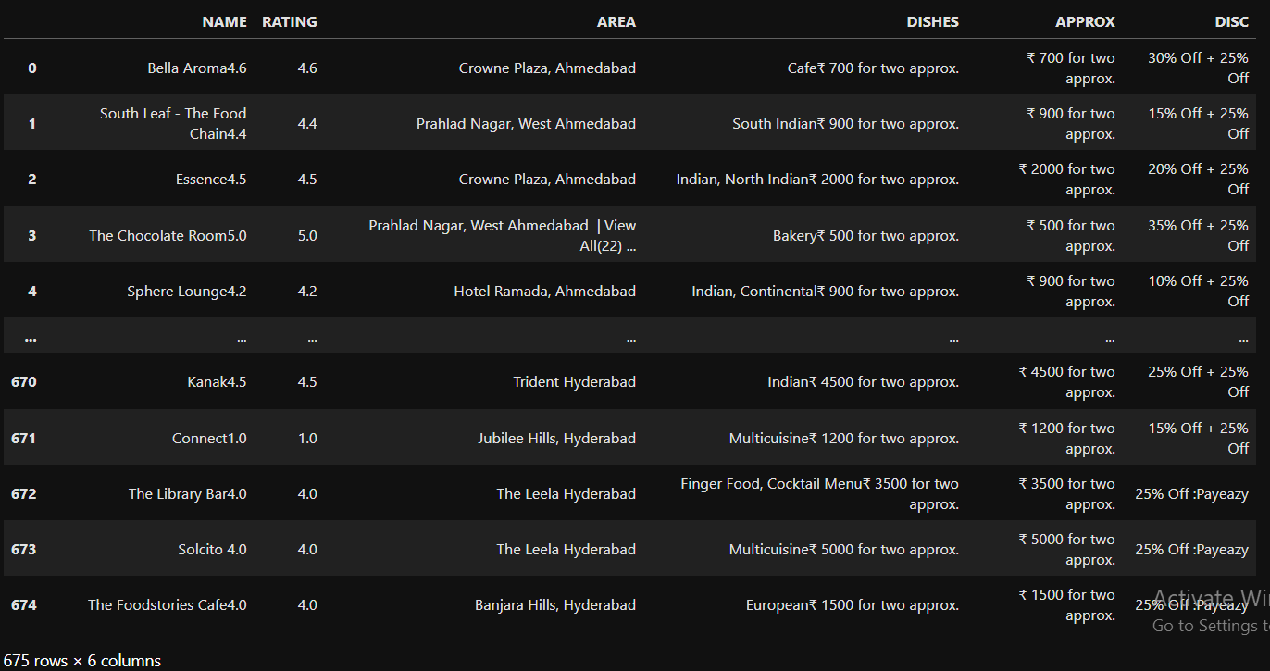
FIRST LOOK AT THE DATA-

Slide 8
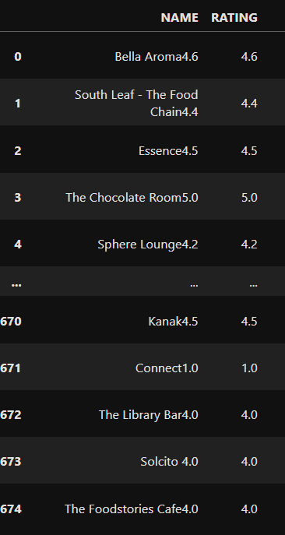
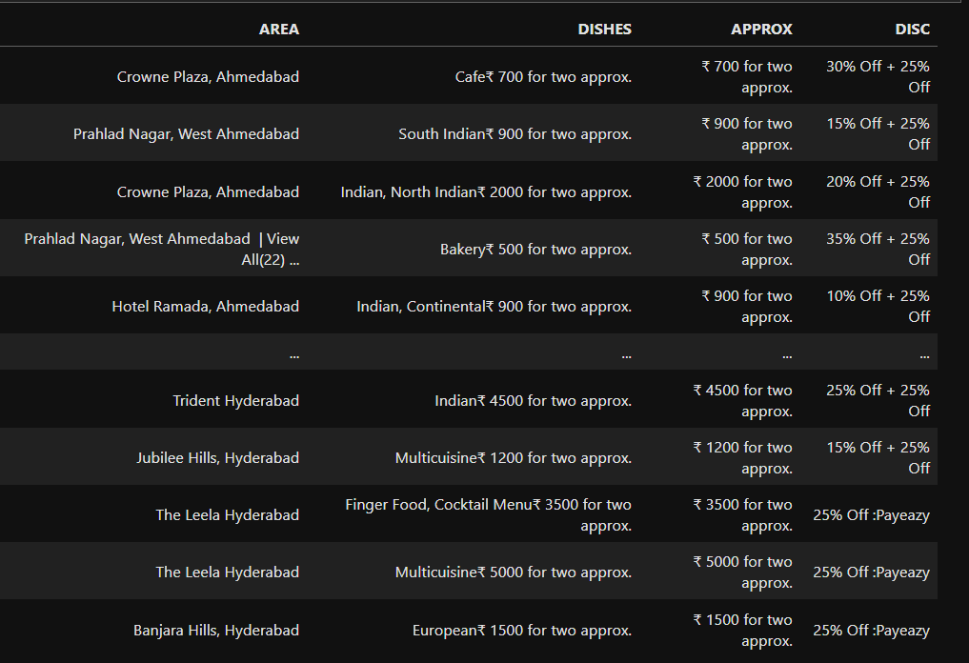
DATA CLEANING AND MANIPULATION-
Cleaning Required to Gain Insights-
The Dataset Shown Requires Cleaning Because Many Restaurant Names, Areas, Dishes, And Discounts Contain Extra Symbols, Merged Text, And Inconsistent Formatting.

Slide 9
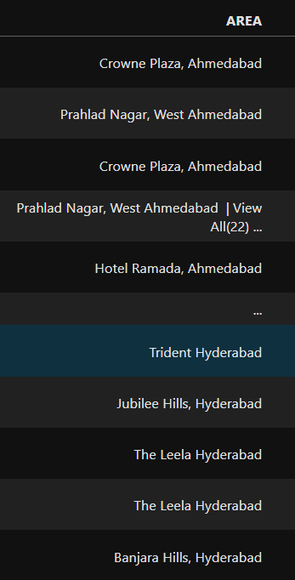
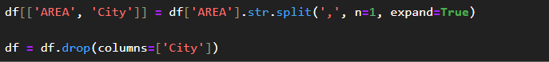
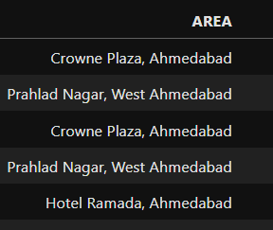
UNWANTED TEXT REMOVE – AREA COLUMN
The Cleaning Process Removed Unwanted Text Like “View All” And Extra Symbols, Resulting In A Cleaner And More Consistent AREA Column

Slide 10
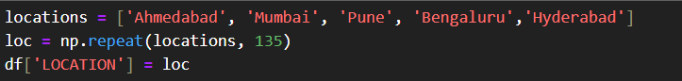
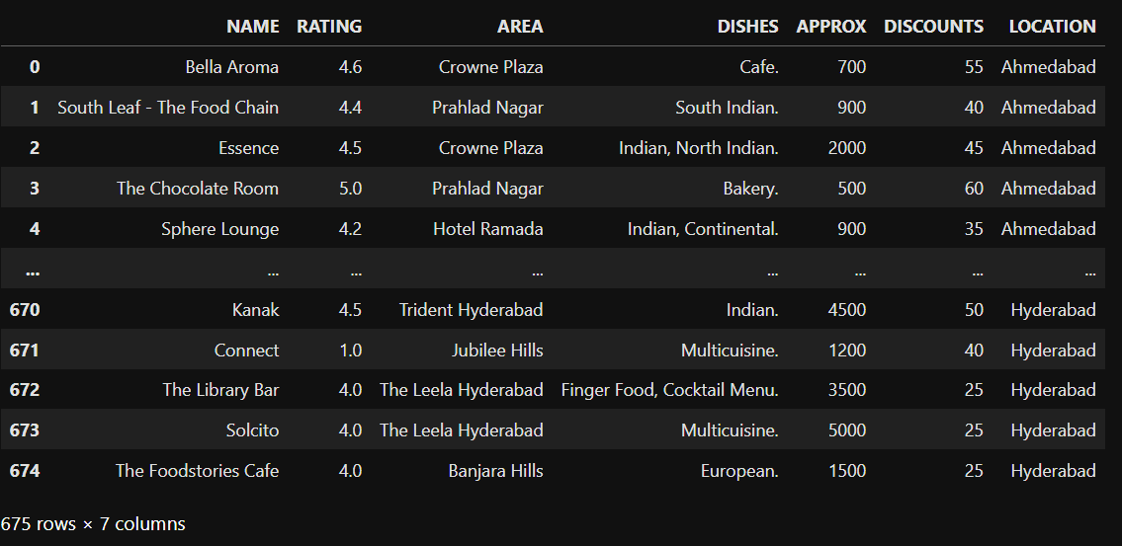
Deriving New Column LOCATION ​-
A New Column Called LOCATION Is Added To The Dataset.
This Helps Us Analyze Restaurants City By City.

Slide 11
FINAL LOOK OF THE DATA-

Slide 12
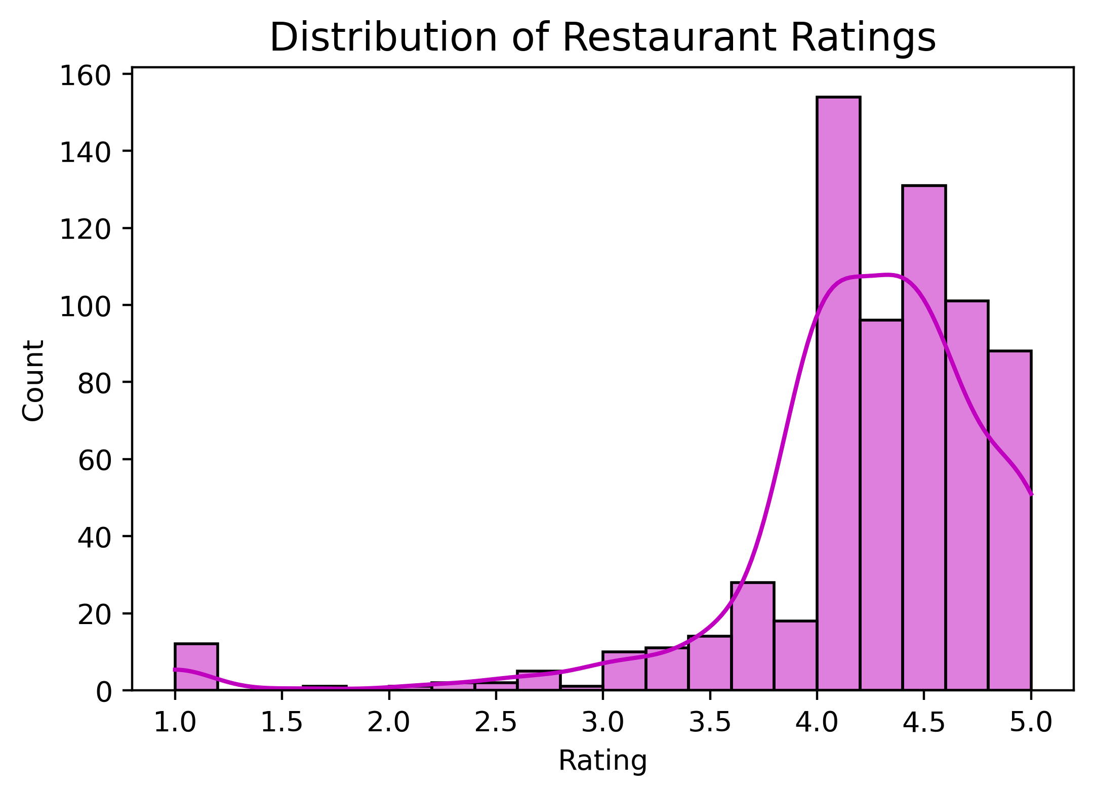
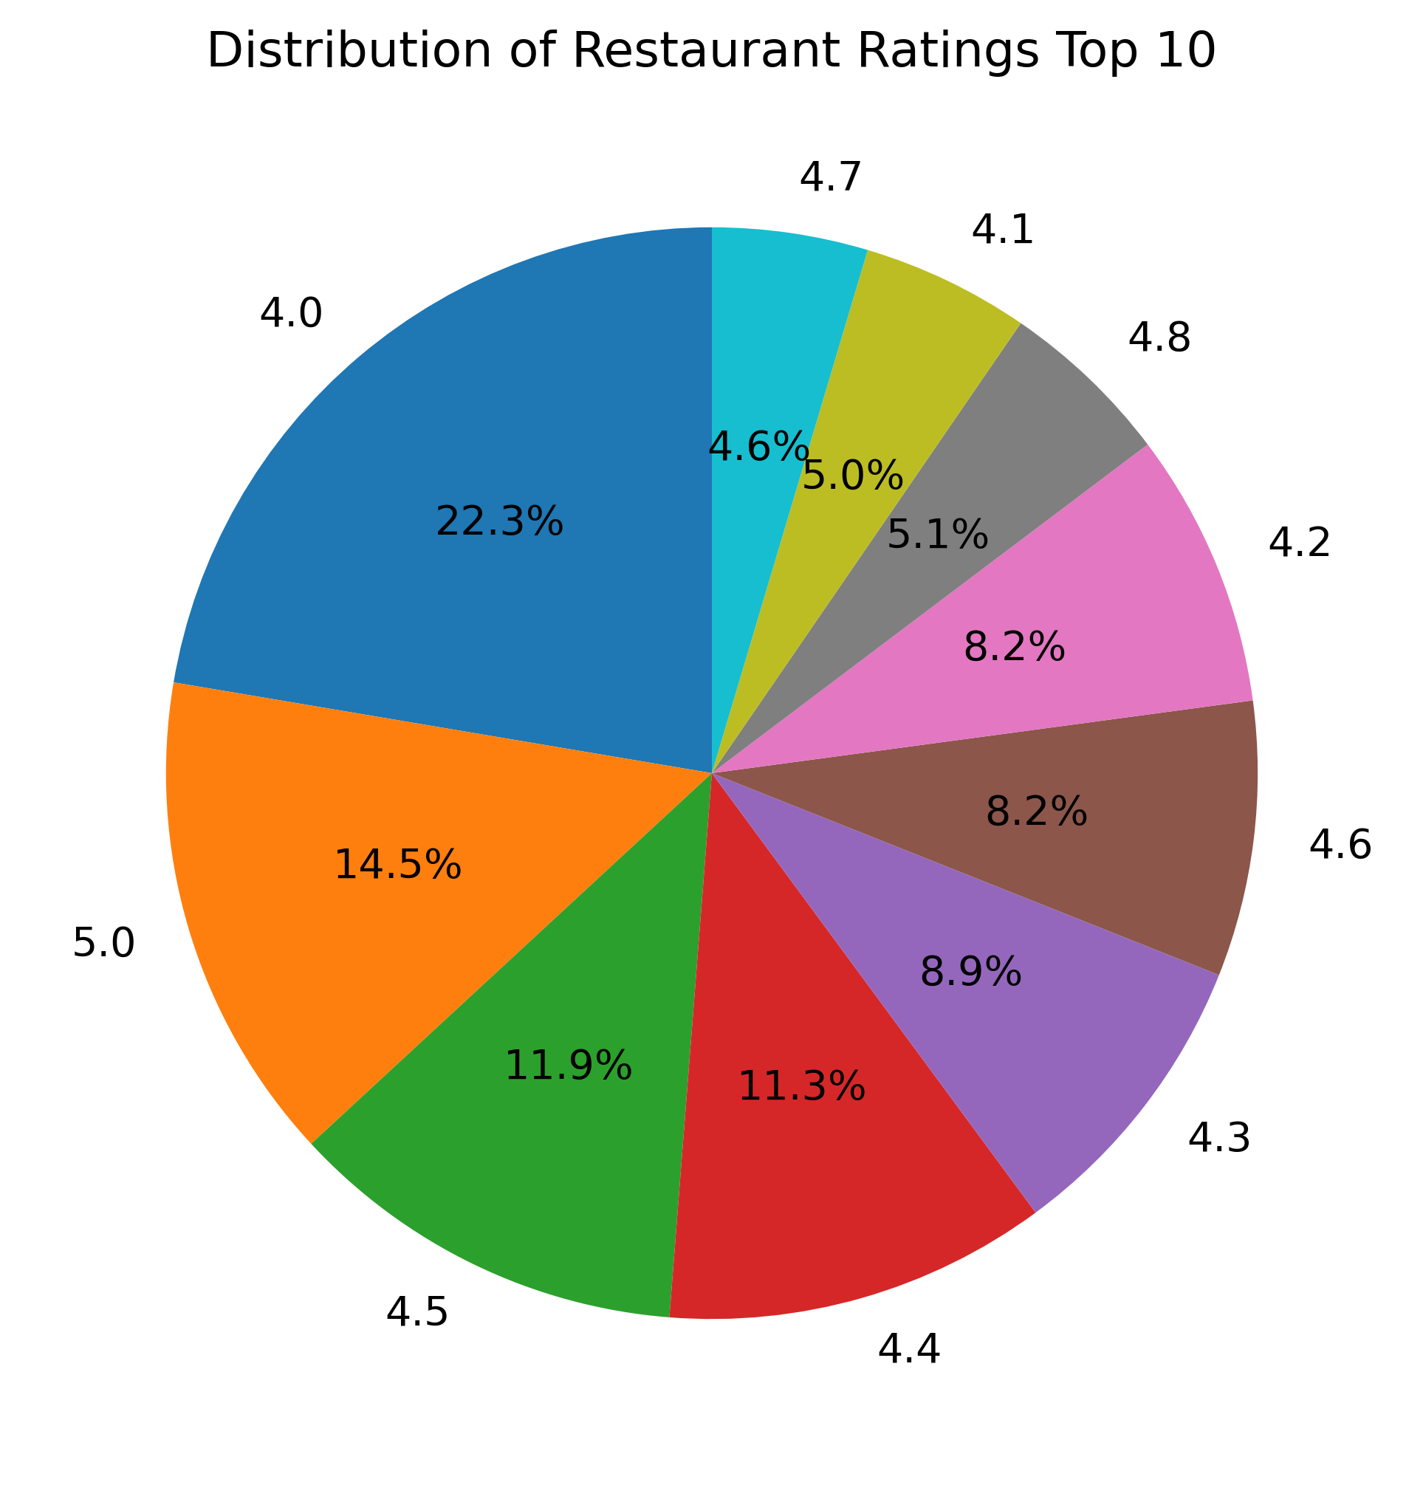
UNIVARIATE ANALYSIS
DISTRIBUTION OF RESTAURANT RATINGS
Most Restaurants Have Ratings Between 4.0 And 4.5.
Pie chart breaks down the top 10 most frequent rating values.
Which Indicates That Most Restaurants Are Consistently High Rated.
This Shows That Overall, Restaurants Generally Maintain Good To Excellent Ratings.

Slide 13
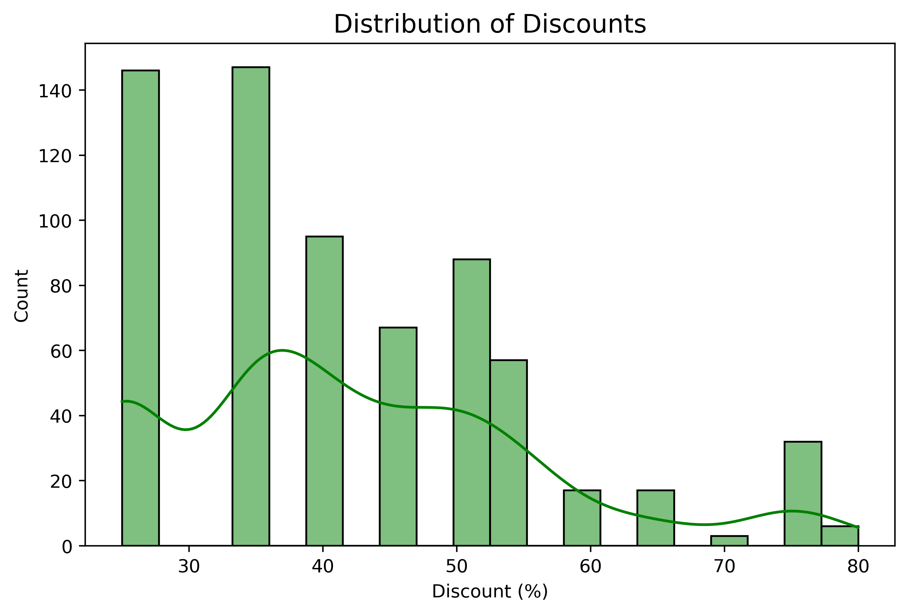

DISTRIBUTION OF DISCOUNTS
Most Discounts Are Around 30% And 35%, As These Have The Highest Count.
Discounts Between 40% To 55% Are Also Common But Less Than 30–35%.
Overall, Smaller Discounts Are More Frequent Than Very Large Discounts

Slide 14
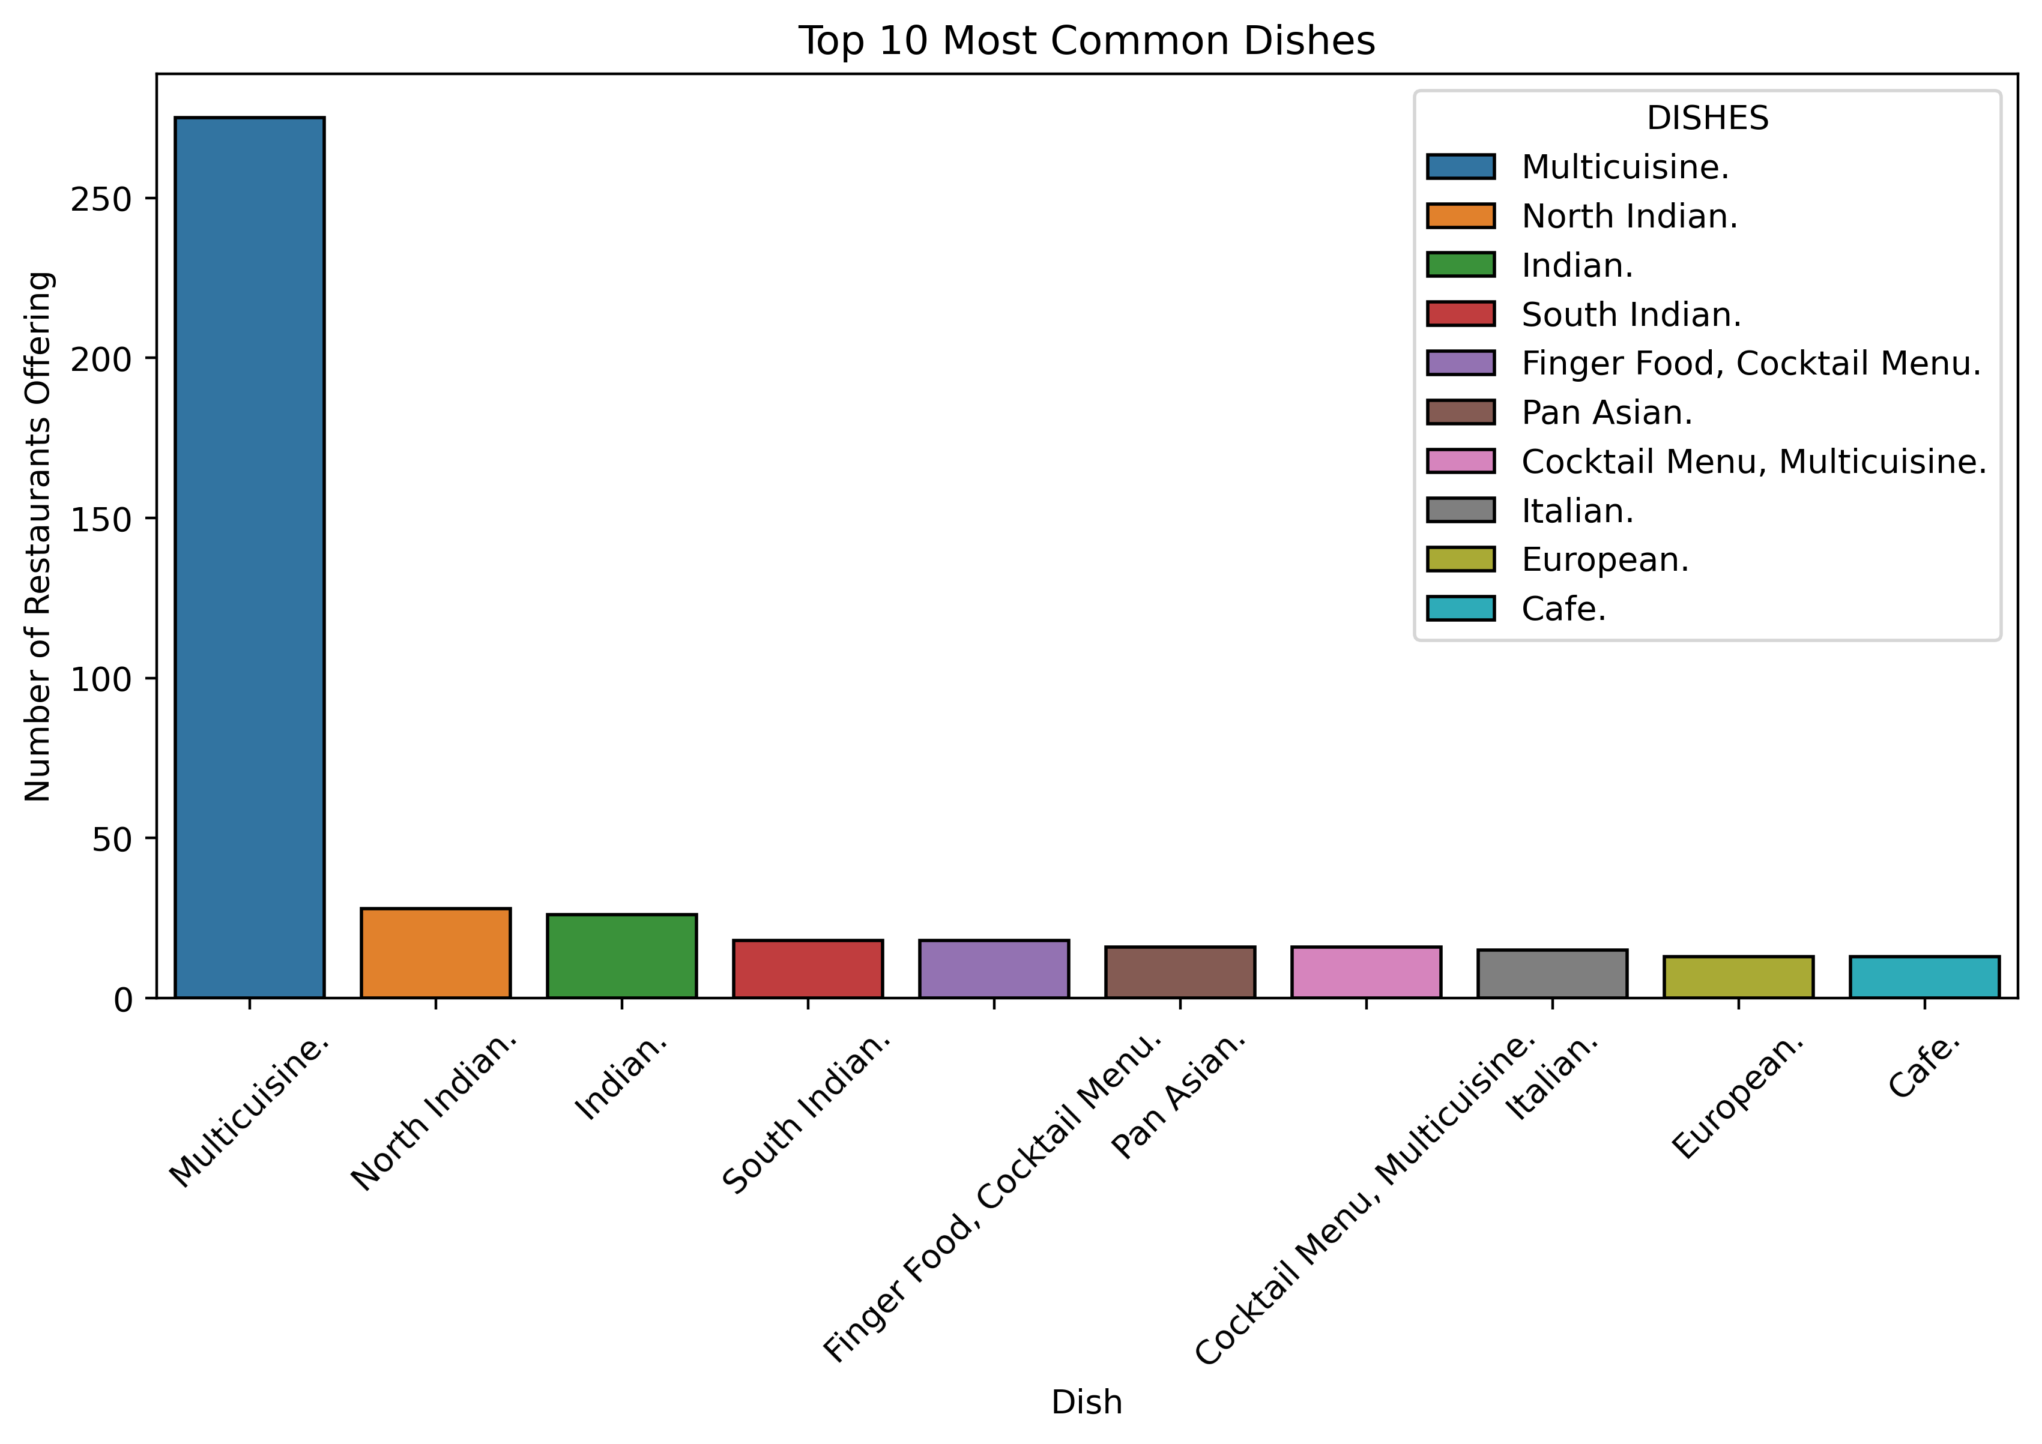
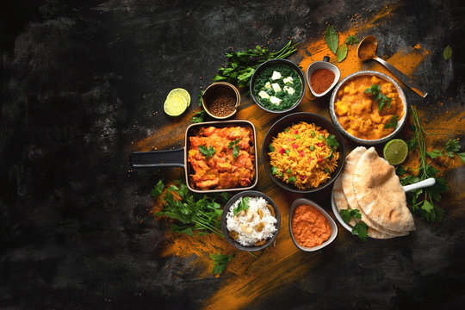
WHAT ARE THE MOST COMMON DISHES OFFERED
Multicuisine Is The Most Common Dish Offered By Restaurants (More Than 270).
North Indian And Indian Dishes Are The Next Popular, But Much Lower In Number.
South Indian, Finger Food, Pan Asian, And Cocktail Menus Are Less Common.
Italian, European, And Café-style Dishes Are The Least Offered.

Slide 15
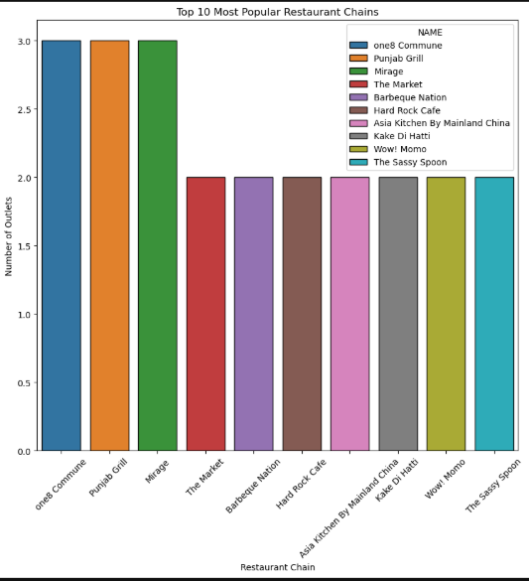
WHICH RESTAURANT CHAINS ARE THE MOST POPULAR
One8 Commune, Punjab Grill And Mirage Are The Most Popular Chains With The Highest Number Of Outlets Among The Top 10.

Slide 16
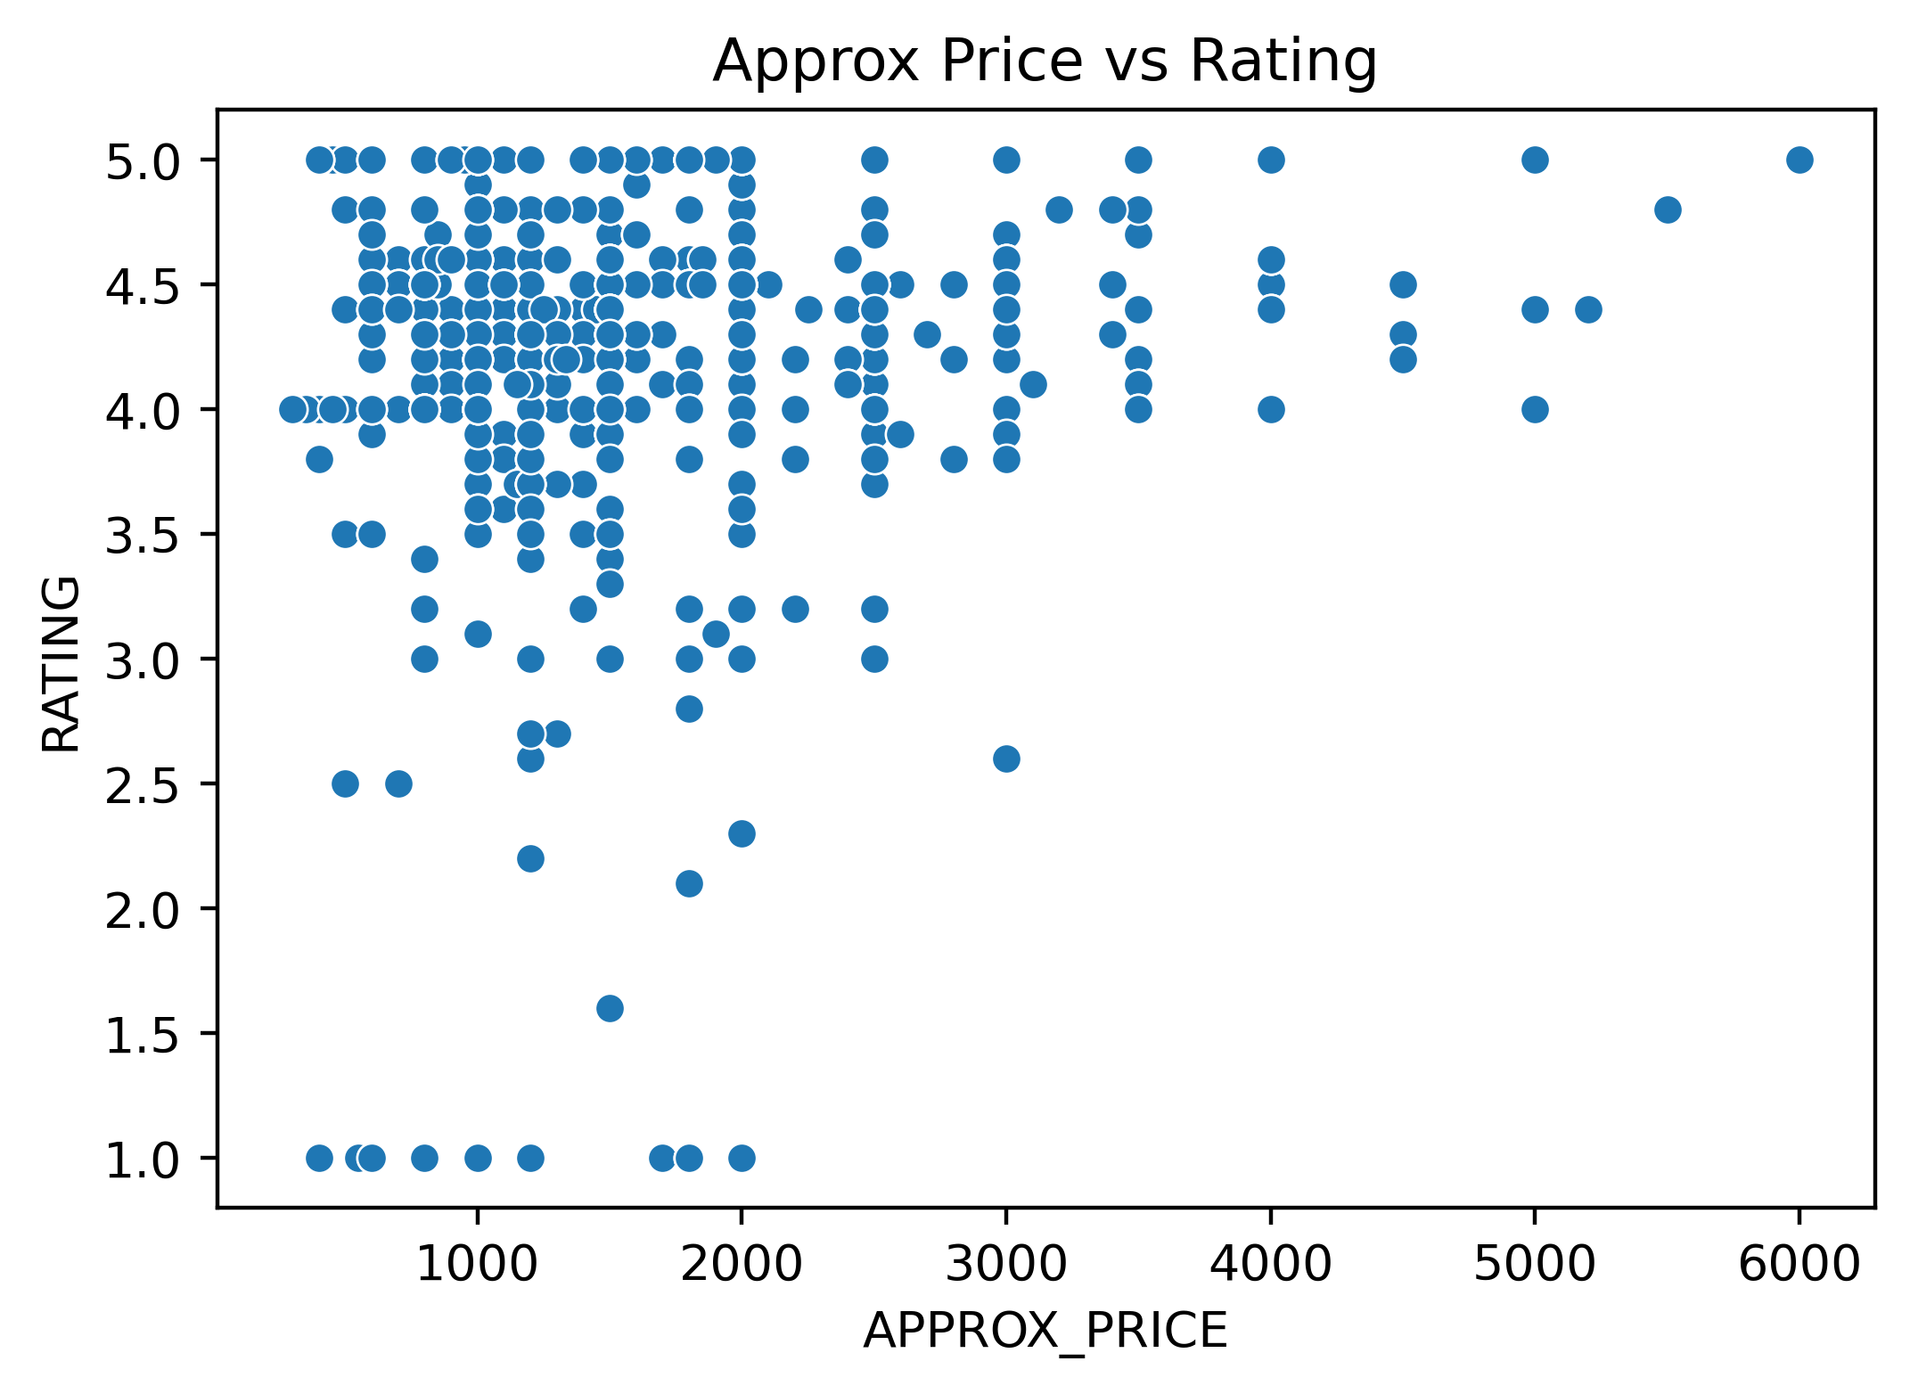
BIVARIATE ANALYSIS-
IS THERE RELATION BETWEEN PRICE AND RATING
Most Restaurants, Regardless Of Price, Have Ratings Clustered Between 4.0 To 5.0.
Low And Mid-priced Restaurants (Below 2000) Dominate The Dataset.

Slide 17
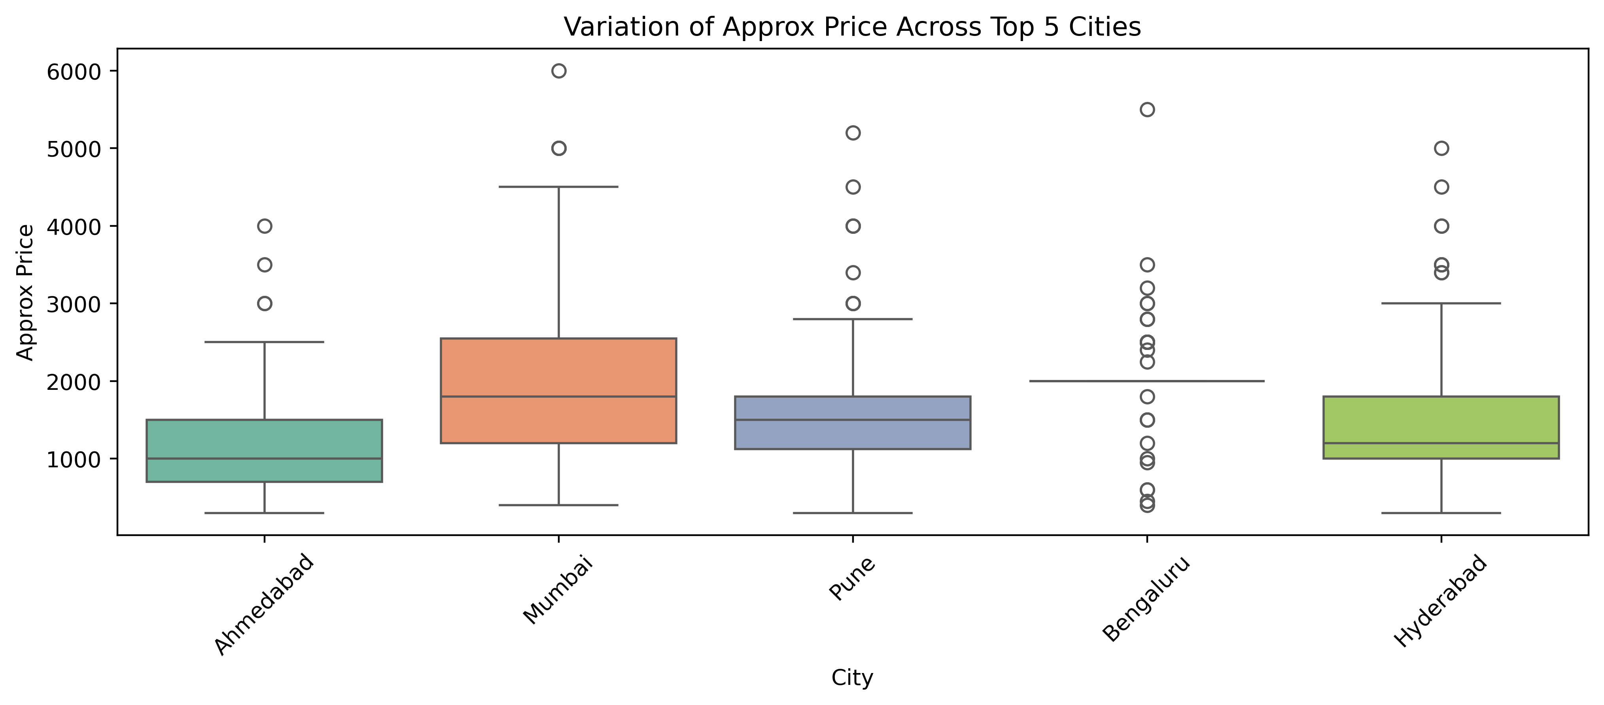
HOW DOES AVERAGE PRICE VARY ACROSS CITIES
Mumbai Has The Highest Average Restaurant Prices Among The 5 Cities.
Ahmedabad Has The Lowest Average Prices.
Bengaluru, Pune, And Hyderabad Are In The Middle Range.
All Cities Have Some Restaurants With Very High Prices.

Slide 18
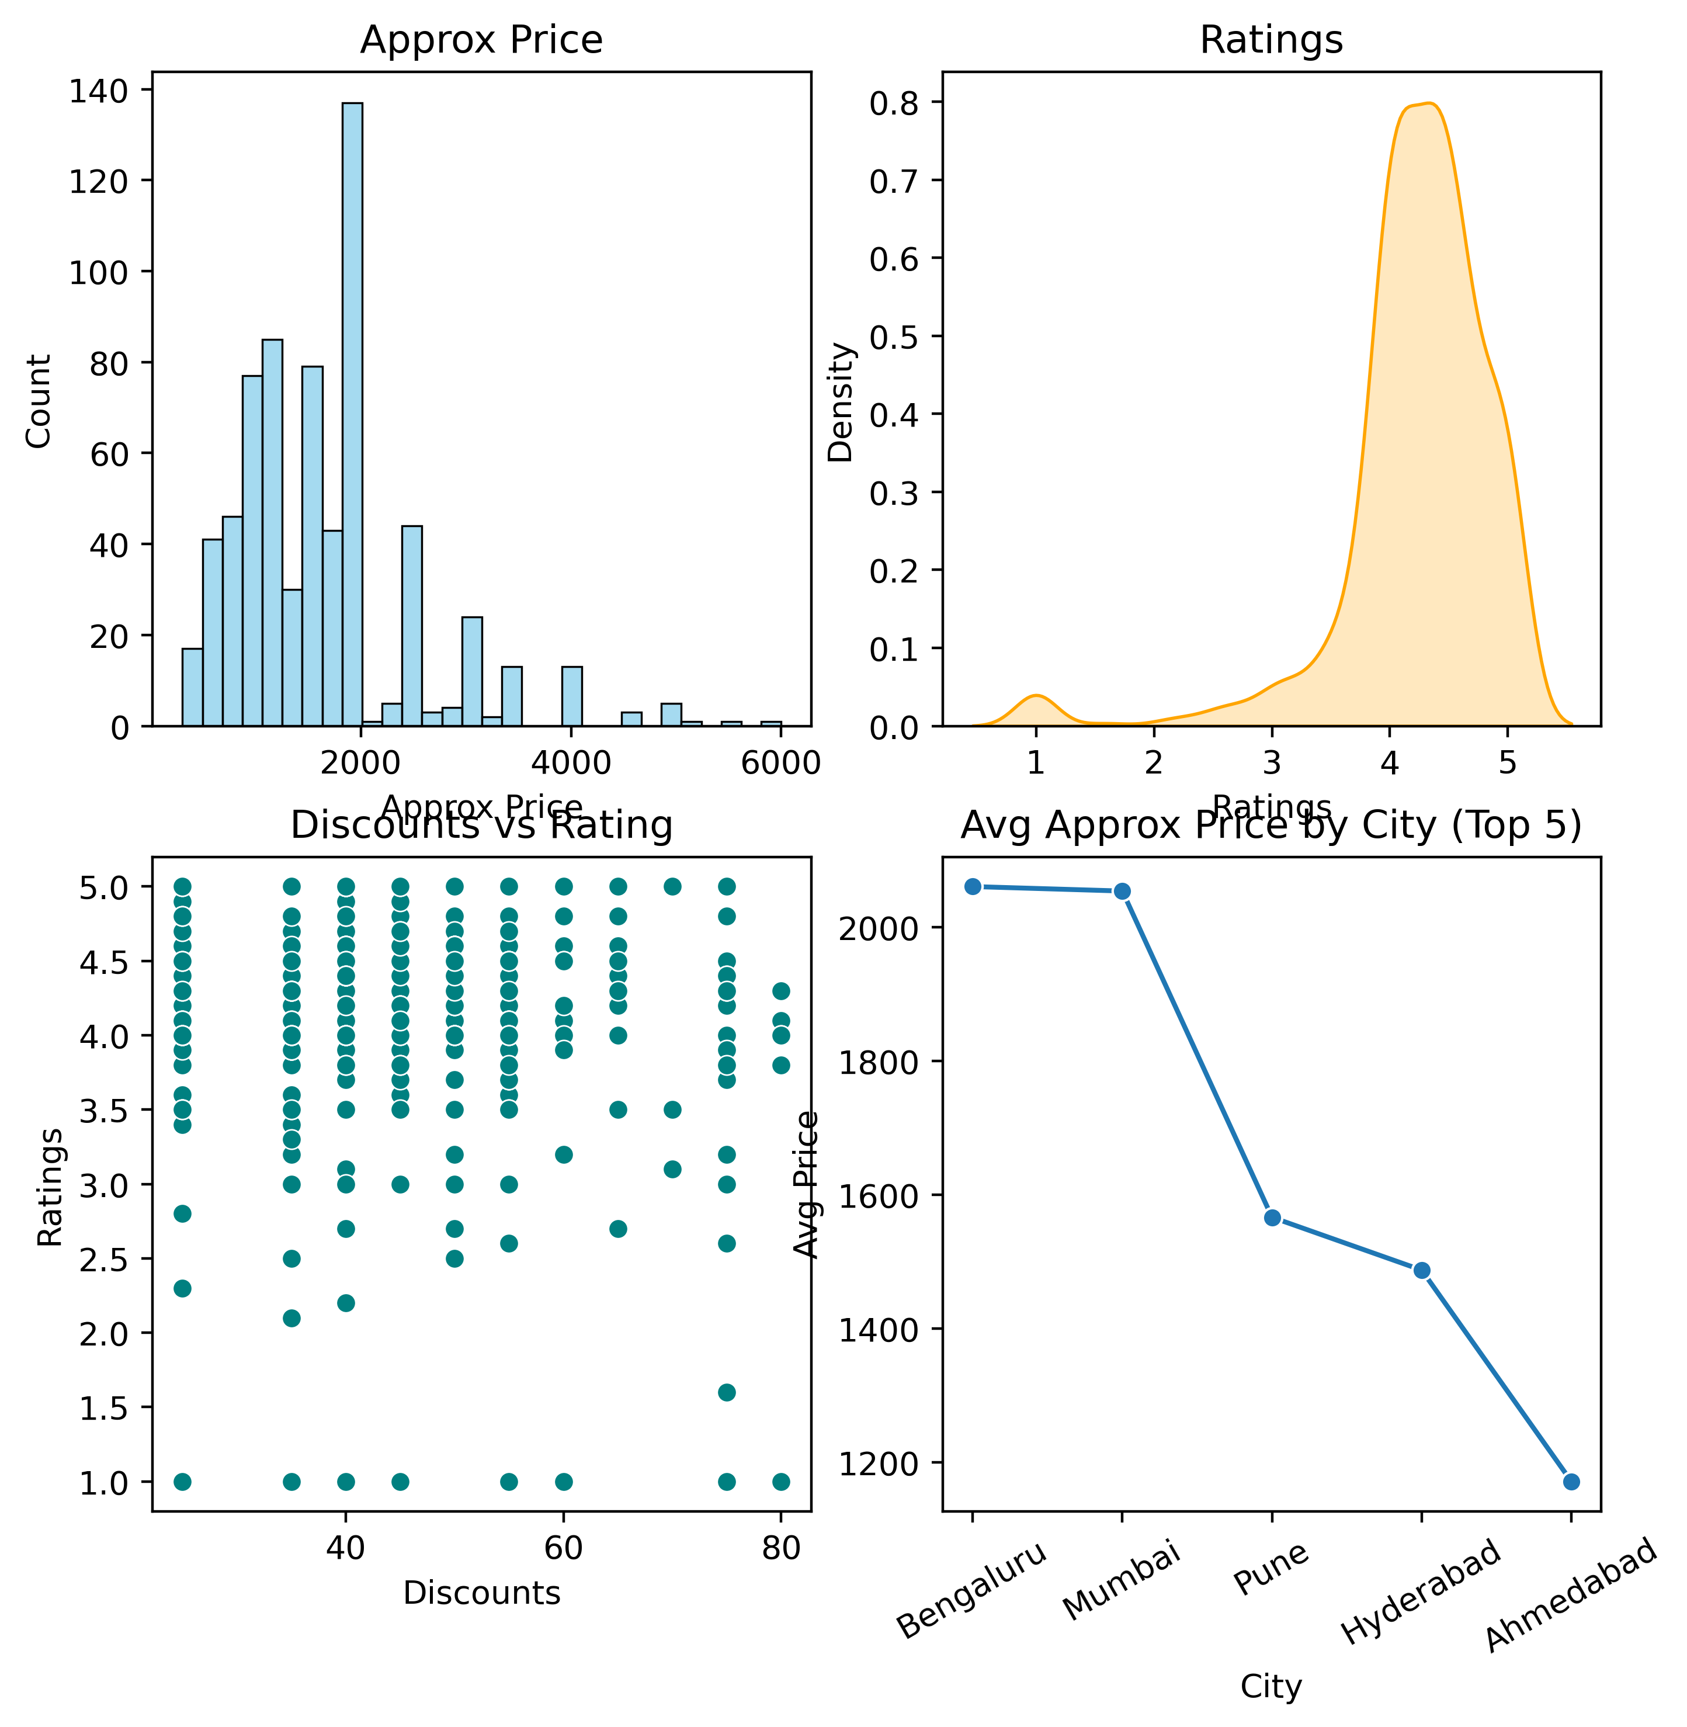
RESTAURANT PRICE, RATINGS, DISCOUNTS, AND CITY-WISE ANALYSIS
Most Restaurants Charge Between 1000–2500. Very Few Go Beyond 4000+. Distribution Is Right-skewed.
Most Ratings Are Between 3.5–5. Very Few Are Below 2. Peak Around 4–4.5.
Discounts Range 30–80%, But Ratings Spread Across All Values. Discounts Don’t Always Guarantee Higher Ratings
Bengaluru And Mumbai Are The Costliest (~2000). Pune And Hyderabad Moderate (~1500). Ahmedabad Cheapest (~1150).

Slide 19
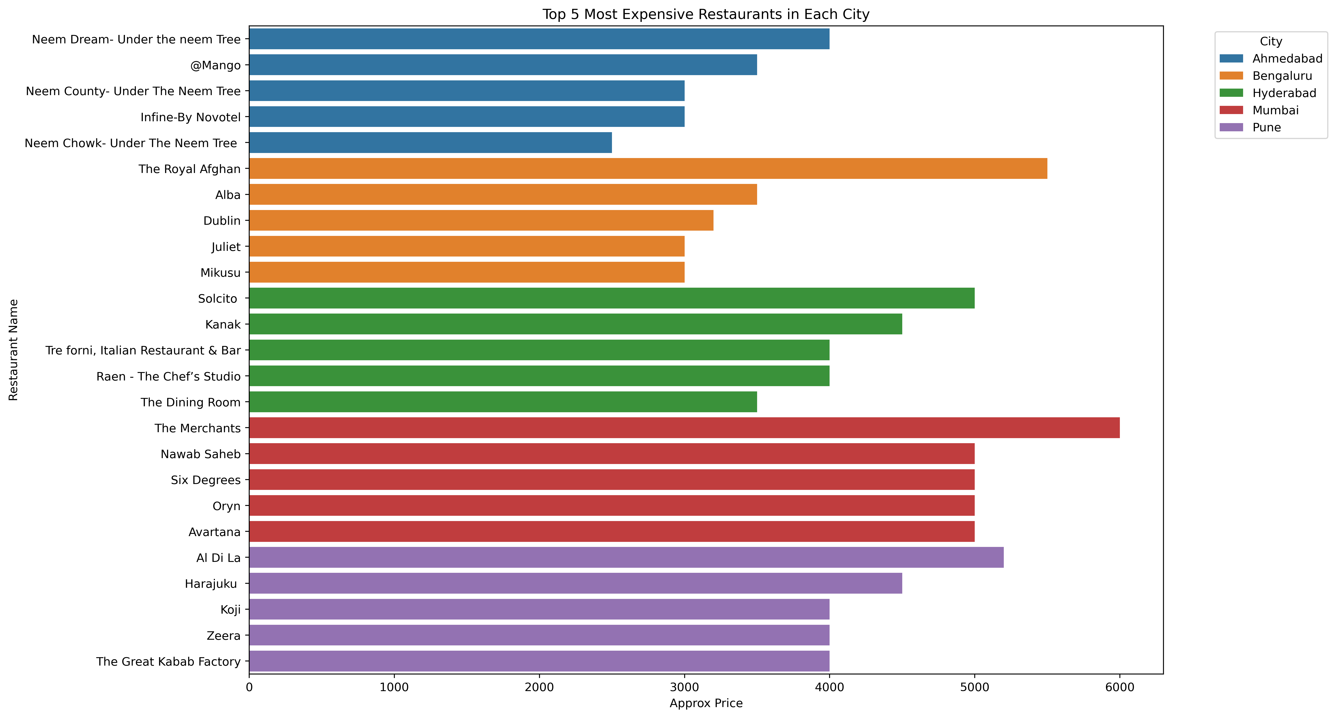
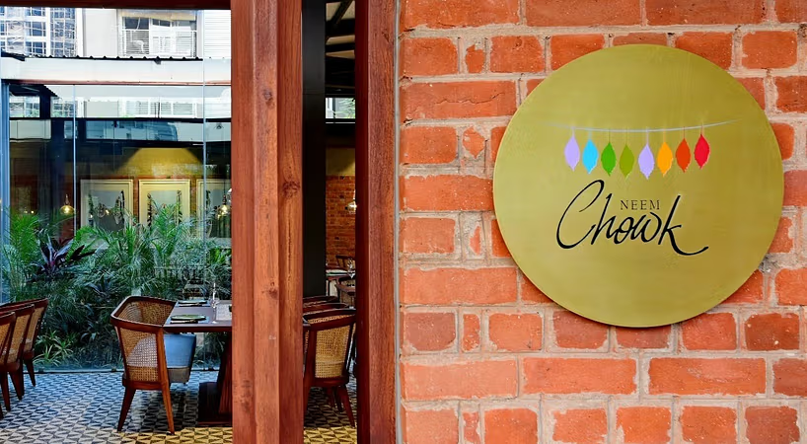

TOP 5 MOST EXPENSIVE RESTAURANTS IN EACH CITY

Slide 20
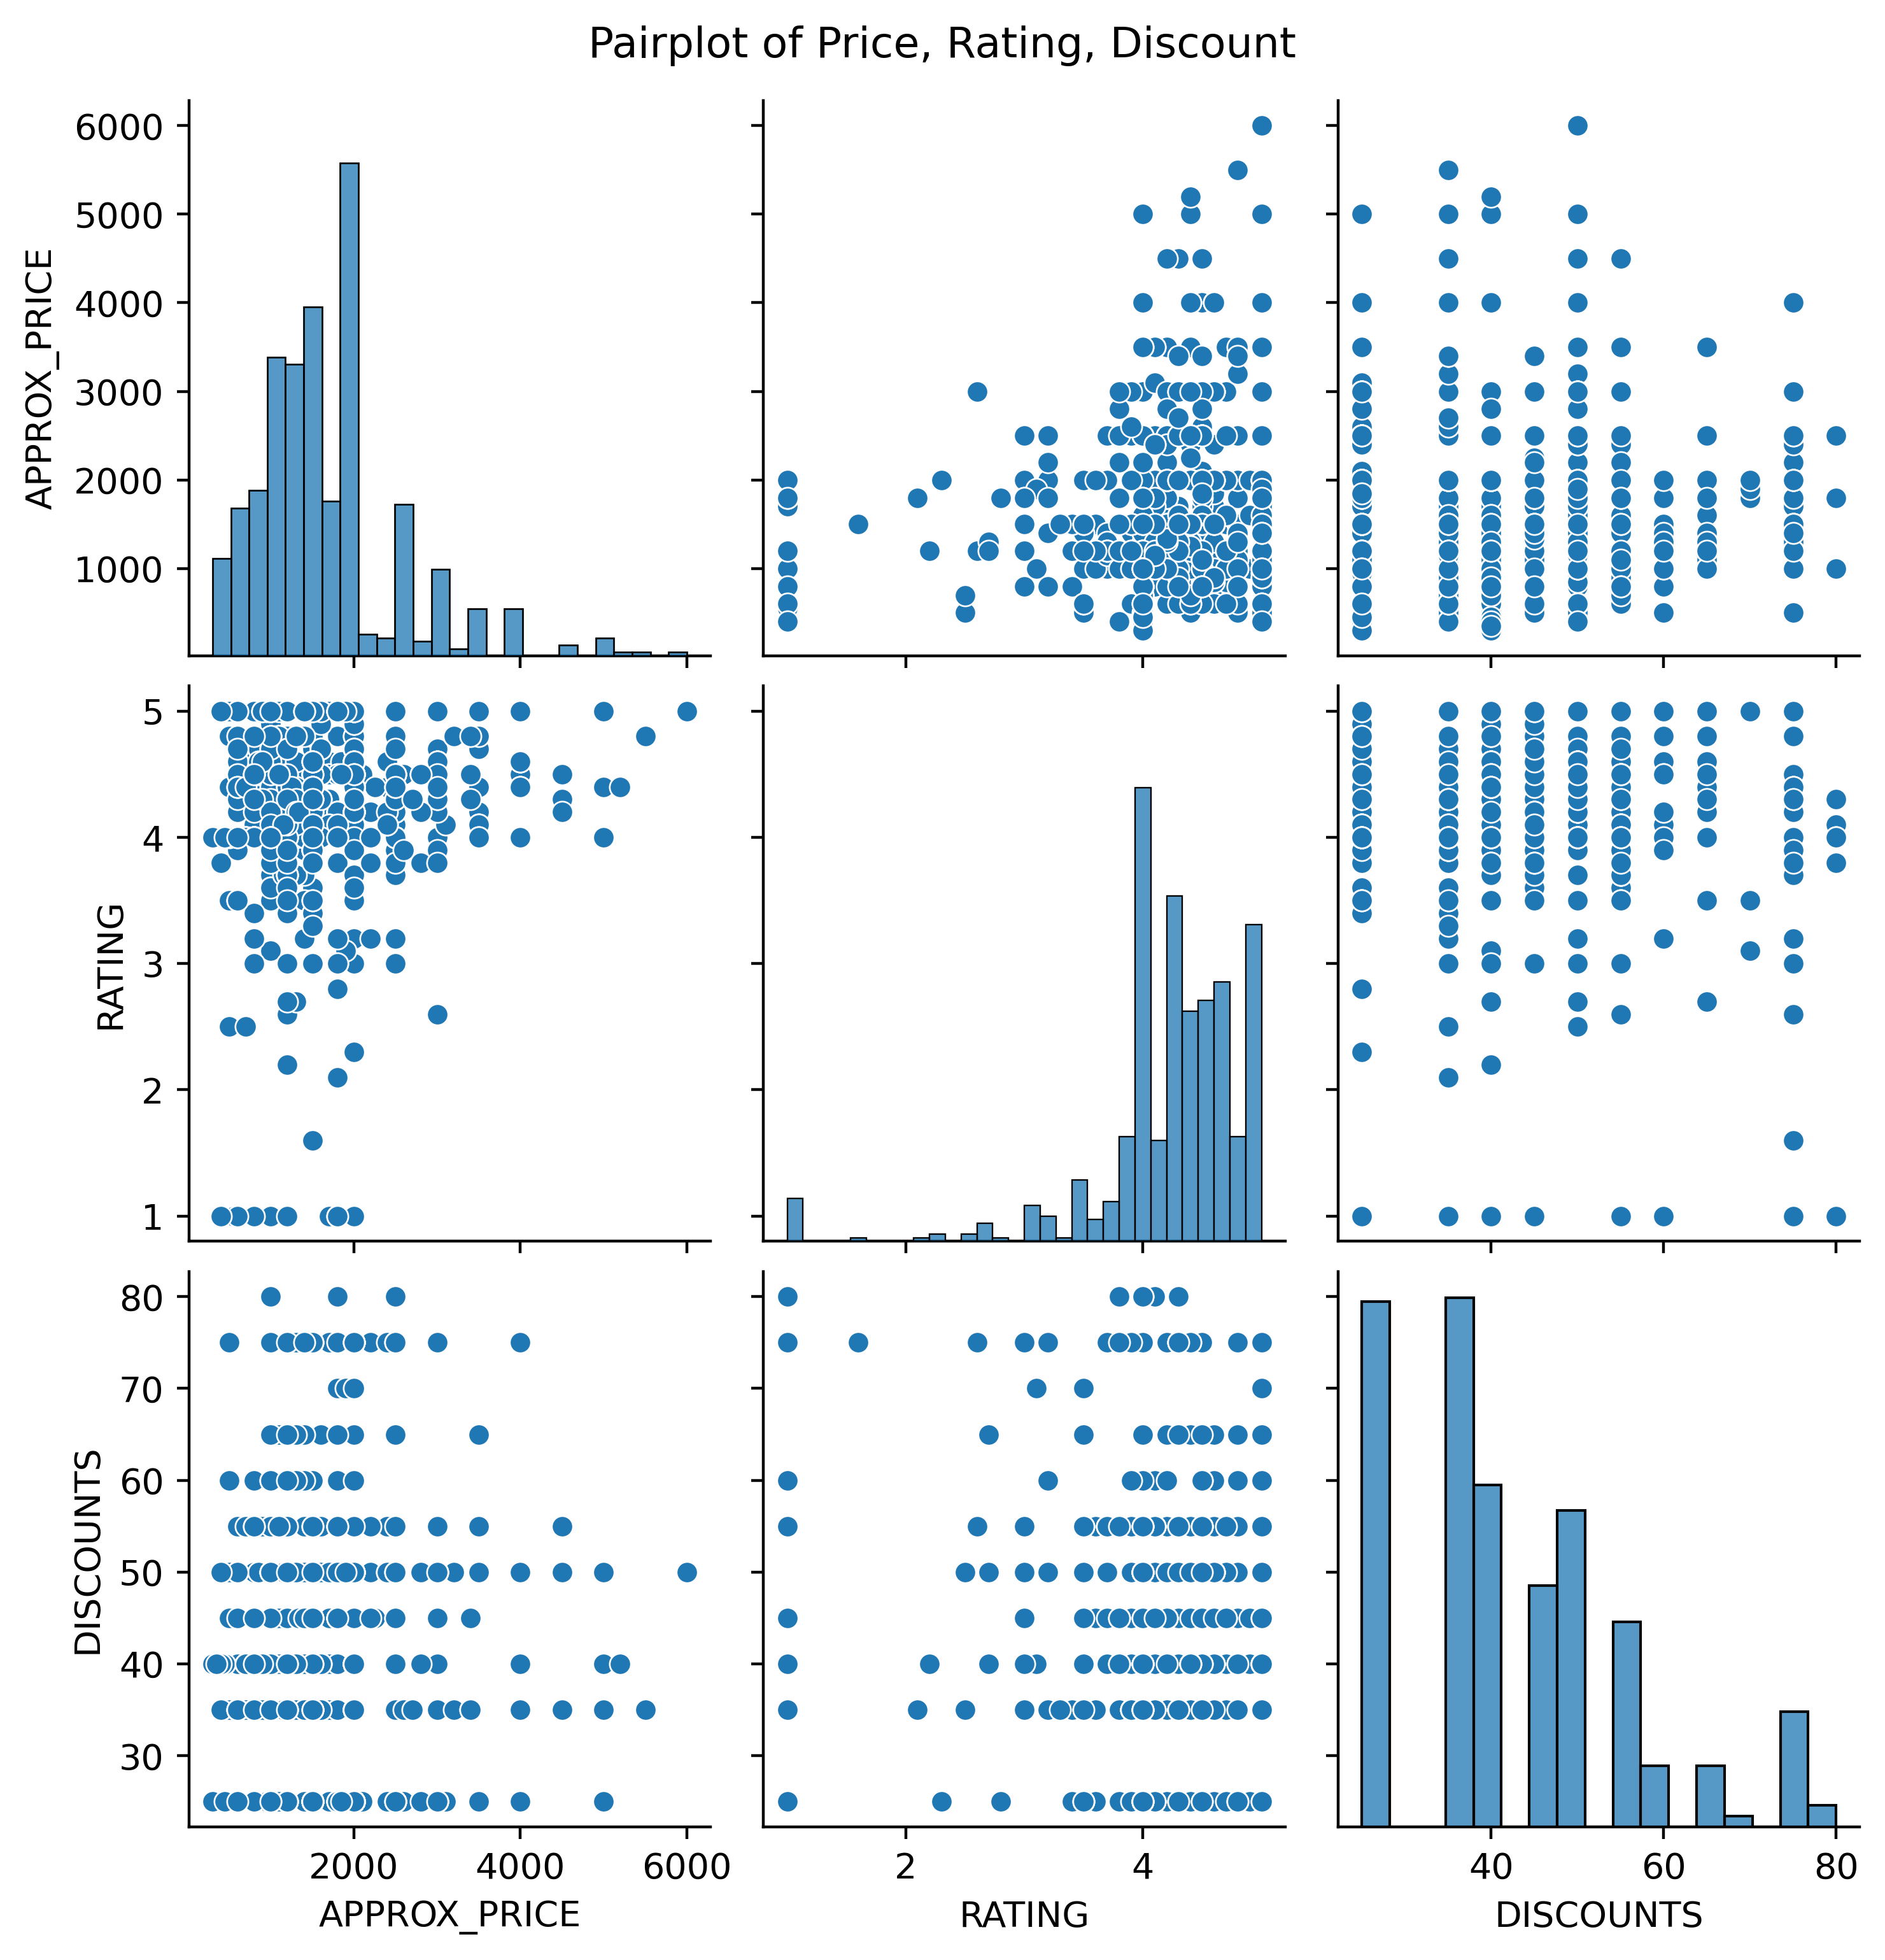
WHAT IS THE JOINT RELATIONSHIP BETWEEN PRICE, DISCOUNT, AND RATING

Slide 21
CONCLUSION
The Analysis Of Eazydiner Data Revealed Clear Trends In Cuisines, Pricing, Ratings, And Discounts Across Major Indian Cities. Most Restaurants Maintain Good Ratings (4.0–4.5), With Multicuisine And North Indian. Being The Most Popular Offerings. Mumbai Emerged As The Costliest City, While Ahmedabad Was The Most Affordable. Discounts Were Typically 30–35%, Through Higher Promotional Offers Existed In Select Cases. The Study Highlights That Price Does Not Strongly Affect Ratings, And Discounts Alone Don’t Guarantee Customer Satisfaction. Overall, The Project Demonstrates How Web Scraping And EDA Can Uncover Valuable Insights Into Consumer Preferences And Market Opportunities In The Urban Food Industry.

Slide 22


